Slide 1



Keystroke Recognition using WiFi Signals
Kamran Ali
Dept. of Computer Science & Engineering
Michigan State University
Alex Liu
Wei Wang
Muhammad
Shahzad
Notes:
Hi, I am Kamran Ali from Michigan State University.
I am going to talk to you about how we can recognize small gestures such as keystrokes using Wi-Fi signals.
This is joint work with my colleagues: Alex, Wei and Shahzad.

Slide 2
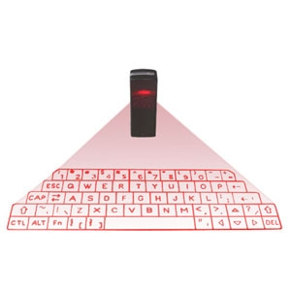
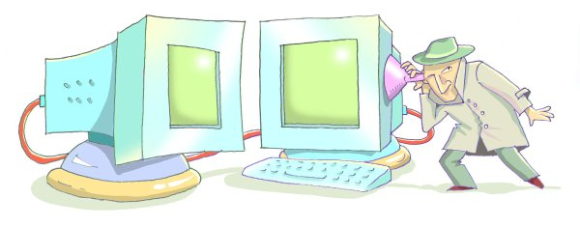
Keystroke Recognition
Good
Bad
Virtual Keyboards
Keystroke Eavesdropping
Notes:
So, why is it important at all to study different ways of recognizing keystrokes?
First of all, wireless keystroke recognition systems can allow realization of new technologies like Virtual Keyboards.
While on the other hand, such schemes can also pose a privacy and security threat where attackers can eavesdrop on what users are typing.

Slide 3


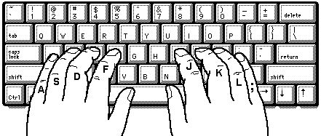
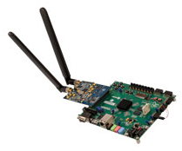
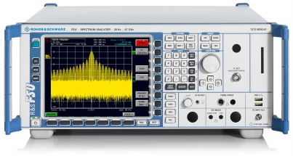
Previous keystroke recognition schemes
Camera based
Sound based
EM Radiations based
SDR based
Notes:
Several ways have been proposed in the past for recognizing keystrokes wirelessly,
Such as analyzing the videos of users typing on a keyboard
or analyzing sounds and electromagnetic signals emitted from different keystrokes,
or very recently, using software defined radio based customized receivers to localize keystrokes.

Slide 4
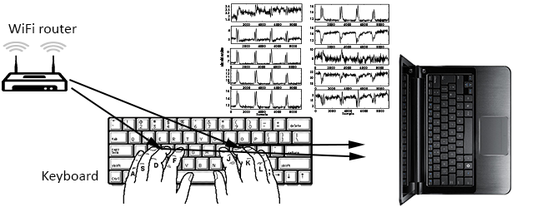
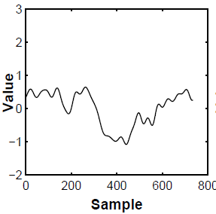
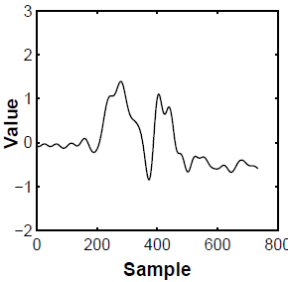
Can we recognize keystrokes using commodity WiFi ?
WiKey
Key observations:
  Keystrokes impact WiFi signals – multipath changes
  Different keystrokes impact WiFi signals differently
Channel
State
Information
(CSI)
Letter
Letter
I
O
Notes:
We ask the question, can we recognize keystrokes using commodity Wi-Fi ? And the answer is Yes.
We present WiKey, a keystroke recognition scheme which uses channel state information extracted from commodity WiFi devices to recognize keystrokes.
WiKey is based on the key observations that typing impacts WiFi signals and different keystrokes impact wifi signals differently…
…This is because hands and fingers of a user move in a certain direction and formation for each different keystroke.
For example, here you can see some processed CSI waveforms of two different keystrokes I and O. You can notice that these waveforms are fairly different from each even though I and O are placed adjacent on a keyboard.

Slide 5
Challenges
Keystrokes are small gestures
  Constitute small motions
  Closely placed on keyboard
  Closely spaced in time
  Key challenge
Detection and extraction of clean
CSI waveforms for different keystrokes
Notes:
However, recognizing keystrokes using CSI information reported by commodity WiFi devices is not that easy. As compared to gestures like pushing, pulling or waving, keystrokes are relatively quite small gestures
Keystrokes constitute small motions.
They are very closely placed on the keyboards.
They are closely spaced in time as well.
So the key challenge we face while using channel state information extracted from commodity WiFi devices, is how we can detect and extract clean CSI waveforms for different keystrokes.

Slide 6
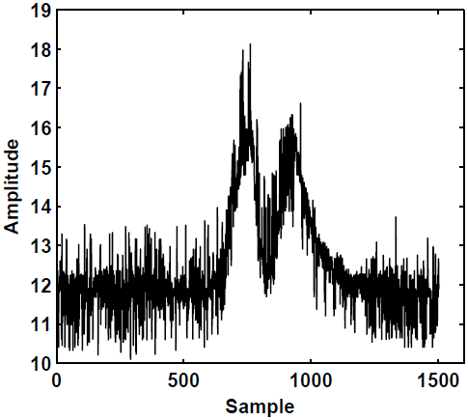
Noise Reduction
Noisy CSI in all subcarriers
→ Low pass filtering
CSI variations in subcarriers are correlated
→ 30 groups of subcarriers per TX-RX antenna pair
→ Contain redundant information
Principal Component Analysis (PCA) on subcarriers
→ Select top few projections of CSI data
→ Remove the noisy projections of CSI data
Notes:
The first step of WiKey is reduction of noise in CSI data.
The CSI reported by commercial WiFi devices contains bursty noise mainly due to hardware limitations and multipath interference. This bursty noise can be removed using low pass filtering.
However, too much low pass filtering can lead to loss of detail in CSI waveforms.
We observed that the CSI variations in different subcarriers are correlated. What this means is that among the 30 groups of subcarriers per transmit receive antenna pair, the information carried by CSI data in those subcarriers is redundant.
We utilize this correlation in subcarriers by applying principle component analysis on them. We then select top few projections of CSI data and get rid of the noisy projections. In this way, we ultimately get rid of the unrelated noisy components and only keep the PCA components which represent the variations due to keystrokes.

Slide 7
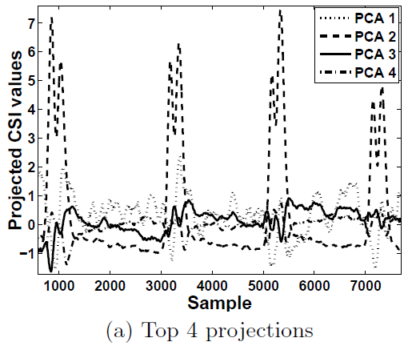
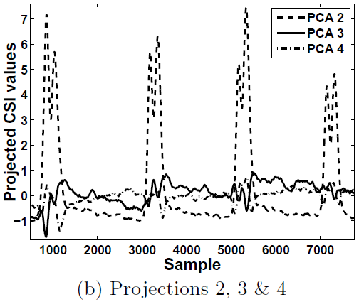
Noise Reduction
Example
Noisy projection
  Adds robustness against unrelated noisy CSI variations
Notes:
This figure shows top 4 projections of CSI data collected for one of the keys.
It can be noticed that 1st projection is the most noisy one in this case.
Removing that projection and selecting the remaining three projections gives us cleaner CSI data which can be further processed to extract and recognize keystrokes.
So, essentially, this technique of noise reduction using principal component analysis on subcarriers adds robustness to our WiKey scheme against unrelated CSI variations .

Slide 8
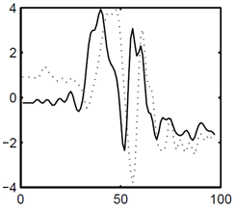
Keystrokes Extraction
Observation:
Processes waveforms from all TX-RX antenna pairs
Robustly estimates the start and end points
→ Combines results from all TX-RX antenna pairs
Keystrokes extracted using start and end points
Typical increasing and decreasing trends in
rates of change in CSI time-series
Notes:
After noise reduction, the next step is to extract the waveforms of individual keystrokes from clean CSI data.
For keystroke extraction, we leverage the fact that all keystroke waveforms show typical increasing and decreasing trends in the rates of change of CSI values.
Our keystroke extraction algorithm processes CSI waveforms from all antenna pairs and then robustly estimates the start and end points of keystrokes by combining the results from all antenna pairs.
Keystrokes are then extracted using their estimated start and end points.

Slide 9
Feature Extraction
Shapes of keystroke waveforms used as features
  Discrete Wavelet Transform
  Compressed shape features from CSI waveforms
  Applied 3 times consecutively to reduce computational complexity
Notes:
After extracting individual keystroke waveforms, the next step in WiKey is to extract the features from those waveforms.
In order to utilize maximum details in CSI waveforms for keystroke recognition, we chose to use shapes of the waveforms of different keystrokes as the features of those keystrokes.
We used Discrete Wavelet Transform to get compressed shape features from CSI waveforms of different keystrokes .
We chose to apply discrete wavelet transform 3 times in order to reduce the computational complexity of the classification process of WiKey.

Slide 10
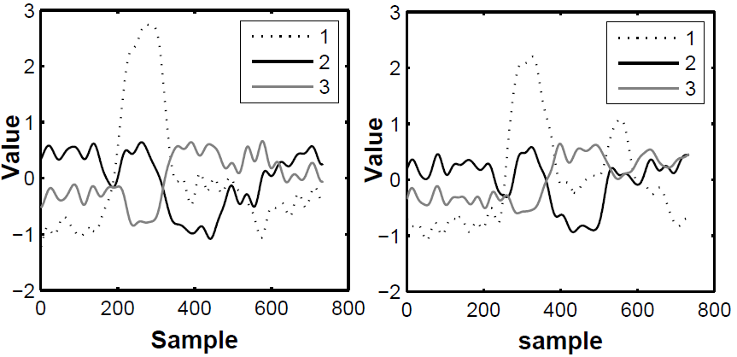
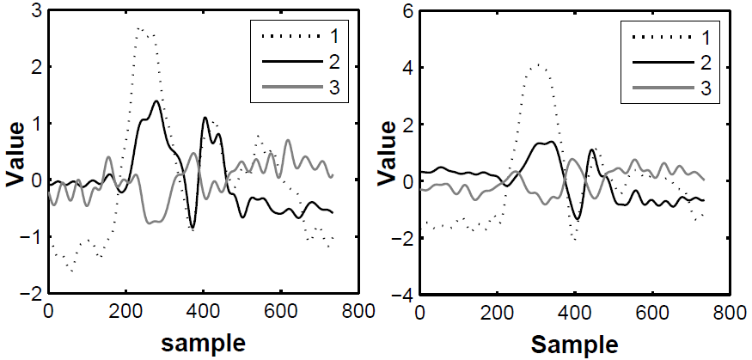
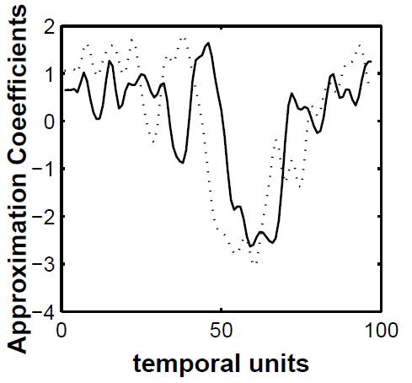
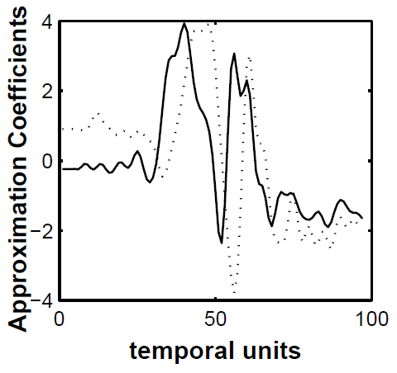
Feature Extraction: Examples
Some DWT Features of keystroke I
Some DWT Features of keystroke O
Notes:
Here we show feature extraction process for 2 different keys I and O.
For example, here are 3 waveforms for key I, obtained from one of the antenna streams after performing noise reduction and keystroke extraction.
And here are the DWT features extracted from one of those CSI waveforms.
Similarly, on the right hand side are some DWT features extracted from one of the CSI waveforms for key O.
It can be noticed that keystroke features for different keys are consistent and different from each other.
** DWT preserves shape and compresses almost 8 times.

Slide 11
Classifier Training
  Dynamic Time Warping
  Comparison metric for shape features of keystrokes
  k-Nearest Neighbor (kNN) Classifiers
  Majority voting on decisions from all classifiers
Total
classifiers
3
x
M_{T} x M_{R}
=
Extracted Keystroke Waveforms
From all antenna pairs
Notes:
After feature extraction, the next step is classifier training.
We chose dynamic time warping to be used as a comparison metric between shape features of different keystrokes in the classification process of WiKey.
We chose to perform classification using kNN classifiers.
We train an ensemble of classifiers, where each classifier is trained using one of the 3 extracted keystroke waveforms from each antenna pair.
During keystroke recognition process, decisions obtained from all classifiers are combined using majority voting to obtain a final decision.

Slide 12


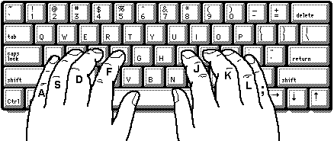
Data Collection
Experimental setup
  Intel 5300 NIC for CSI collection at receiver
  ICMP ping requests sent to router from laptop
Collected data from 10 users
  For both separate keys & sentences
  More than 1480 samples collected from each user
  Inter-keystroke interval ~ 1 second
30 cm
4 m
Laptop with Intel 5300
WiFi NIC
TP-link router
Notes:
Let’s move on to the implementation and evaluation of our keystroke recognition scheme.
We used the famous Intel 5300 NIC installed on a laptop and a TP-Link router for collecting channel state information data.
We placed the keyboard between the laptop and the router such that the laptop and the router are in direct line of sight of each other.
**The receiver was placed approximately 30 centimeters from the keyboard, and the router was placed approximately 4 meters away from the keyboard.
We collected data from 10 users for both separate keystrokes and sentences. Users were asked to type one key at a time, while keeping the interval between keystrokes to be approximately one second.

Slide 13
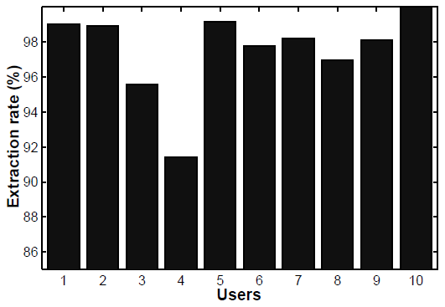
Keystroke Extraction Accuracy
Keystroke extraction achieves average accuracy of 97.5% over all users
Key misses occur due to:
  Inconsistencies in typing behavior
  Keys constituting smaller motions
Notes:
Ok, coming to the experimental results.
First we will show how well our keystroke extraction algorithm performs on different users.
Our experimental results show that our keystroke extraction algorithm achieves an average accuracy of 97.5% over all the users we collected the data from.
However, we observed that some keys were often missed by our algorithm, which happens either
1. Due to inconsistencies in typing behavior
2. Or in cases when the keys being pressed constitute relatively smaller motions such as the keys like ‘f’ or ‘j’ which are often directly underneath the fingers when a user is typing.

Slide 14
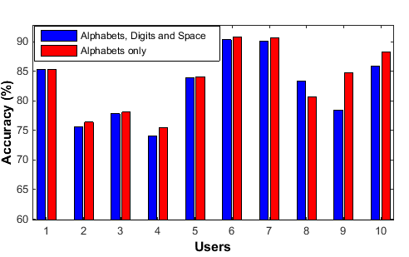
Classifier Accuracy: Single keys
Experiment [1]
Keys A-Z, 0-9 & Space Bar. Samples/key = 30
Slightly smaller accuracies in case of all keys
Reason: Similarity of QWE row with digit keys
User IDs
83% 10-fold cross validation accuracy averaged over all keys and all users
Notes:
Ok, now let’s see the performance of the classification process of WiKey.
First of all, we tested the accuracy of our classifier for single keys.
In the first experiment, we tested 37 keys which included alphabets, digits and space bar.
Our experimental results show that Wi-Key achieves 10-fold cross validation accuracy of 83% averaged over all keys and all users.
We also tested the accuracies achieved in the case when only alphabetic keys were tested. On the graph, x-axis shows the user ID and y-axis shows the percentage accuracy for 2 different cases. Blue bars show keystroke recognition accuracies when experiment was performed on all 37 keys and Red bars show keystroke recognition accuracies when the experiment was performed on only alphabetic keys.
We noticed slightly smaller accuracies in the case where all 37 keys were tested. The main reason behind this is the similarity in motion while pressing keys on QWE row with the digit row which leads to higher confusion in the classification process.

Slide 15
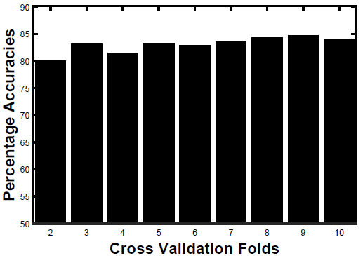
Classifier Accuracy: Single keys
Experiment [2] – Performed for user #10
  Changing percentage of training set from 50% to 90%
  Keys tested A-Z. Samples/key = 80
Multifold cross validated accuracies stayed >= 80%
Accuracies for keys like
‘j’, ‘k’, ‘v’, ‘e’ dropped
< 60%
Notes:
In the second experiment, we studied the effect of increasing the percentage of training set from 50% to 90% by increasing the number of folds in cross validation procedure from 2 to 10.
This time we only tested our classifier on alphabetic keys and used 80 keystroke samples. This experiment was only performed for user 10.
The results show that the cross validation accuracies stayed greater than 80% for all the folds.
However, we observed that accuracies for the keys like j k v e dropped below 60% in case when only 50% of the data was used for training.
This again happens because these keys constitute relatively smaller motions as compared to other keys typed by the user.

Slide 16
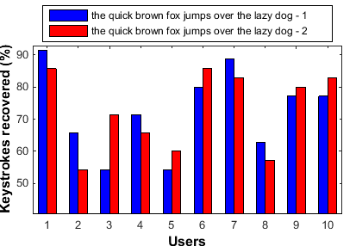
Classifier Accuracy: Sentences
Experiment [1]
- Users typed 1 sentence
with 2 repetitions
- 30 training samples
per key
User IDs
Average accuracy of 77.43% over all users
Notes:
Moving on to the experiments in which we tested the accuracies of our classifier on sentences typed by different users.
In the first experiment on sentences, we tested the accuracy of our classifier on 1 sentence which was typed by all users 2 times.
For classifier training, we used 30 samples per key in this experiment.
Wi-Key was able to achieve an accuracy of more than 77% averaged over all 10 users.
We observed that for some users, the accuracy was as good as 90%, however for some them it was as bad as 55%.

Slide 17
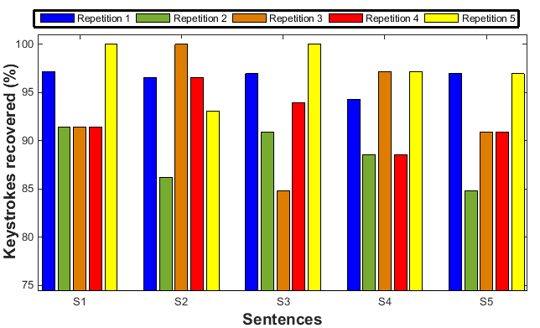
Classifier Accuracy: Sentences
Experiment [2] – Performed for user #10
80 training samples, 5 sentences, 5 repetitions
Average accuracy increased from 80% to 93.47%
Notes:
In the second experiment on sentences, we tested the accuracy of our classifier on 5 sentences typed by user 10.
Each sentence was repeatedly typed 5 times by the user.
In this experiment, we increased the number of training samples from 30 to 80 samples per key.
We observed an overall increase in average keystroke recognition accuracy from 80% to more than 93% for this user.
The minimum keystroke recognition accuracy achieved in this case was approximately 80% and the highest accuracy was 100%.

Slide 18
Limitations
Tested in interference free surroundings
Affected by change in the positions of Wi-Fi devices
Supports relatively slower typing speeds
  Approximately 15 words/minute
Requires high CSI sampling rate
  Approximately 2500 samples/sec
Requires many training keystroke samples per key
Notes:
Although our scheme works well in controlled cases, it has some limitations in real world scenarios.
First of all, WiKey requires interference free surroundings i.e. no other major motion other than typing should occur in the environment.
Secondly, WiKey is affected by positioning of WiFi devices, that is, it needs to be trained again for new settings.
Thirdly, WiKey supports relatively slower typing speeds of around 15 words per minute.
Fourthly, WiKey requires high CSI sampling rates of around 2500 csi samples/sec in order to such high accuracies.
And lastly, WiKey requires many keystroke samples per key in order to achieve reasonable recognition accuracies.

Slide 19
Conclusions
Wi-Fi based keystroke recognition scheme
Correlations in Wi-Fi subcarriers can be leveraged to reduce noise
Propose a robust algorithm for keystroke extraction
Shapes of CSI waveforms
→ effective features for recognition of small gestures
Wi-Key can achieve more than 90% keystroke recognition accuracy for reasonable typing speeds
Notes:
So, lets conclude that talk! In this presentation
We introduced you to our keystroke recognition scheme, WiKey, which uses commodity WiFi devices to recognize keystrokes.
We show that correlations in different subcarriers can be leveraged to remove noisy components in CSI data.
We also propose a robust algorithm for extracting keystroke waveforms from CSI data
We show that shapes of CSI waveforms prove to be very effective features in order to recognize small gestures such as keystrokes.
And finally, as shown by our experimental results, WiKey can achieve more than 90% keystroke recognition accuracy for reasonable typing speeds

Slide 20

Questions ?
Thank you!

